Slide 1
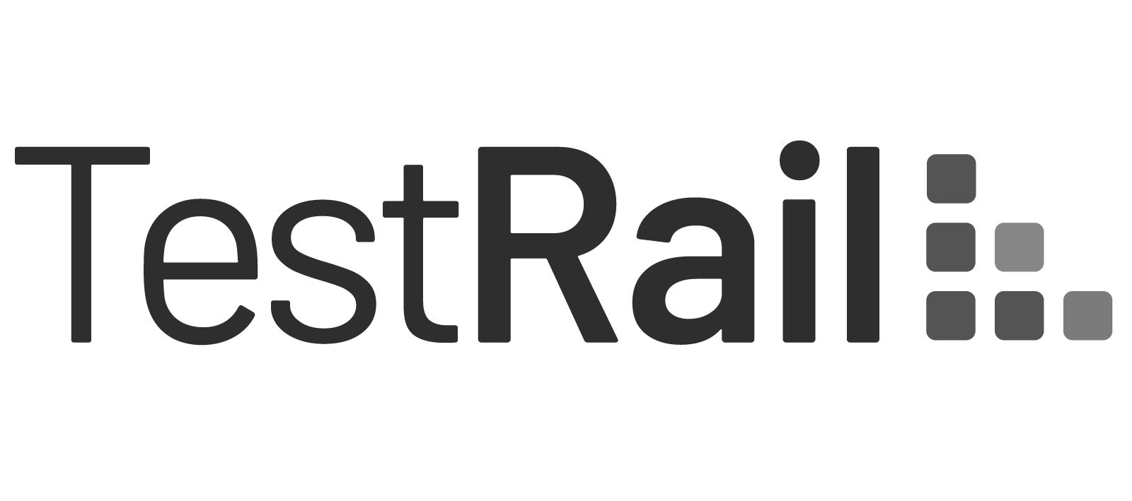
+
YOUR PARTNER TO FUTURE SUCCESS
TO BUILD A BETTER WORLD
Save More, Migrate Faster:
Xray Cloud Strategy

Slide 2
Special Offer
Elevate Your Cloud Journey with Our Complimentary Assessment Plan!
Limited Time Offer:
Up to 30% Off the Data Migration for the First 10 Companies Based on Your Data!
Sign up!
Secure Your Discount Now!
Schedule a Free Consultation!

Slide 3
Xray Cloud
Exploring the pivotal benefits of embracing Xray Cloud
Empowering agile testing processes, streamlining accessibility across teams, and cultivating a culture of collaboration for optimal project success
Ease of Access
The cloud-hosted platform ensures accessibility and reliability, enabling users to utilize Xray from anywhere
Core Advantages of Xray Cloud Implementation
✓ Accessible from anywhere with internet connection
✓ No upfront hardware investments, reduced maintenance costs
✓ Automatic updates and patches
✓ Seamless collaboration for distributed teams
✓ Integrated REST and GraphQL APIs
✓ Enhanced Security and Compliance
✓ Scalability and Performance
Automatic Updates
Enjoy the latest features effortlessly, as updates are automated, requiring no manual intervention
Cost efficiency
Achieve savings on hardware and maintenance costs, with transparent, predictable subscription pricing for budget certainty

Slide 4
Migration Packages
Migration Phases | Silver (1 - 1000 Artifacts) | Gold (1001-5000 Artifacts) | Platinum (5001-10 000 Artifacts) | Custom (>10 000 Artifacts or Create Custom Package)
Project Assessment | ✓ | ✓ | ✓ | ✓
Team Formation | ✓ | ✓ | ✓ | ✓
Data Analysis | ✓ | ✓ | ✓ | ✓
Requirements Gathering | ✓ | ✓ | ✓ | ✓
Xray Environment Setup | ✓ | ✓ | ✓ | ✓
Data Mapping Setup | ✓ | ✓ | ✓ | ✓
Data Extraction | ✓ | ✓ | ✓ | ✓
Data Transformation | ✓ | ✓ | ✓ | ✓
Data Loading | ✓ | ✓ | ✓ | ✓
Functionality Testing | X | X | ✓ | ✓
Data Validation | X | ✓ | ✓ | ✓
Training | X | X | ✓ | ✓
Documentation Update | X | ✓ | ✓ | ✓
Monitoring | X | X | ✓ (4 hours per week - 1 month) | ✓ (8 hours per week - 3 months)
Bug Fixing | X | X | ✓ (4 hours per week - 1 month) | ✓ (8 hours per week - 3 months)
Duration | After evaluation | After evaluation | After evaluation | After evaluation
Cost | After evaluation | After evaluation | After evaluation | After evaluation

Slide 5
Maximize your savings and migrate faster with ⋮IWConnect
IWConnect offers professional services for migrating from Xray Server to Xray Cloud. With a global network of accredited professionals, we provide support for additional migrations, such as transitioning various test management systems to Xray Cloud
Key Factors
✓ 80 QA Certificated Consultants and Professionals
✓ Customized Scripts & Tools
✓ Best Services Award for 2023 Recognized by Xray
✓ More than 20 successful migrations
Efficiency Boost Focused and detailed planning and strategy for high-level efficiency without interruptions
Team Synergy Misinterpretations are reduced, minimizing rework
Rapid Development Combining all available Tools, Rest APIs, and our custom solutions for faster processing
Precision & Support Continuous monitoring and support for optimizing output

Slide 6
TO BUILD A BETTER WORLD
Thank you!
Let’s meet! Contact us
sales@iwconnect.com

